Slide 1
https://cran.r-project.org
https://www.rstudio.com
Download R from here
Download R studio from here
(it might make your life easier)

Slide 2
Introduction to R
Session 3

Slide 3


Slide 4

Davis et al. (2012) Molecular Psychiatry, 17, 867-874

Slide 5
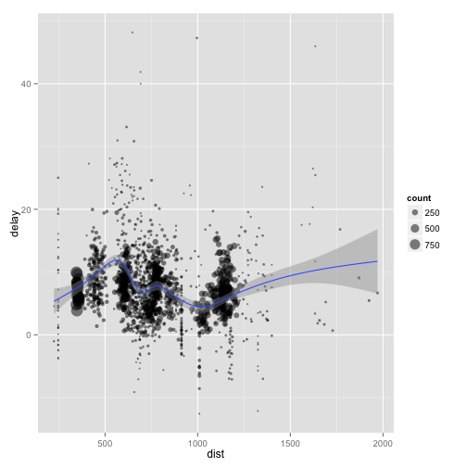
Exploration
Data on 227000 flights that departed from Houston in 2011
For each plane, find how many flights it made, the distance travelled, the delay…

Slide 6
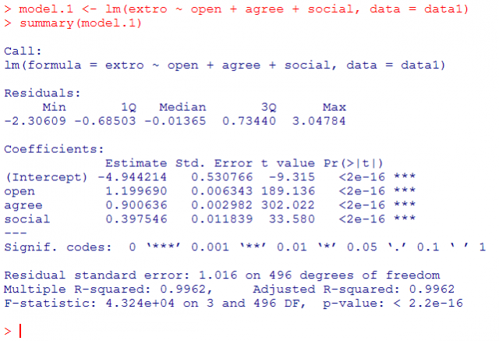
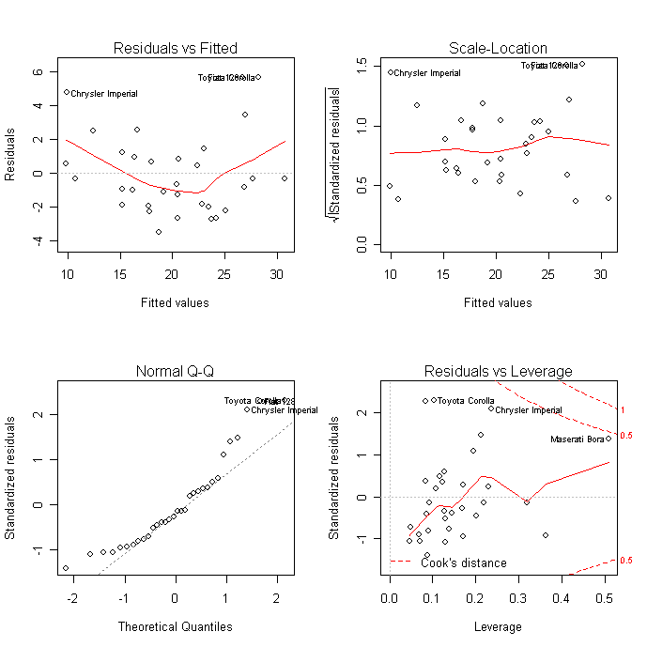
Built by statisticians

Slide 7
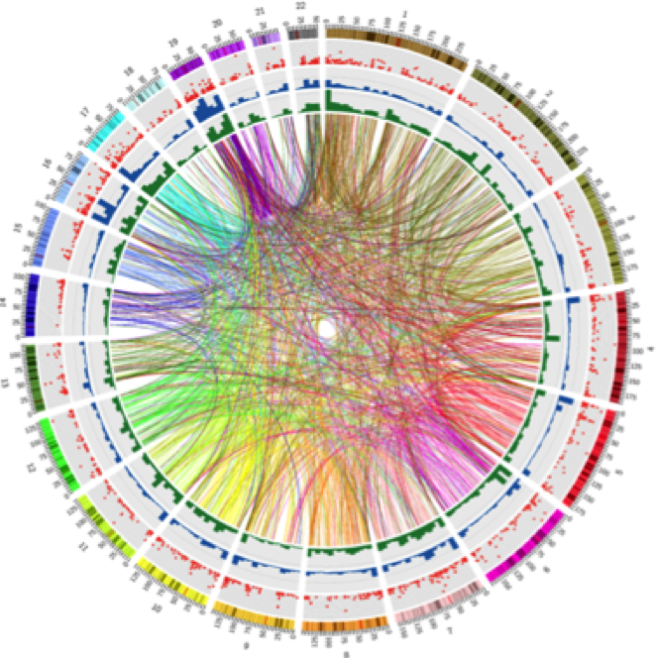
18 trillion tests…

Slide 8
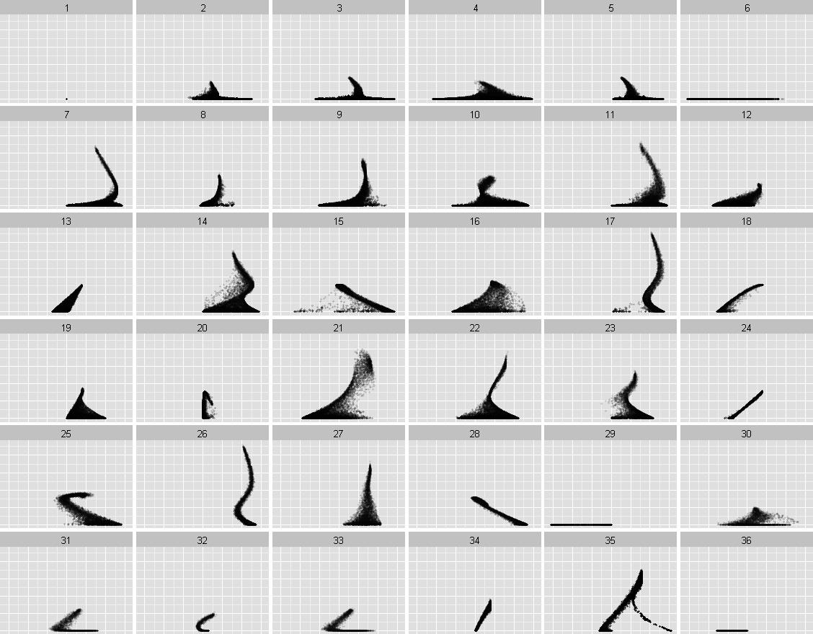

Slide 14
Programming languages
Humans write instructions. Computers execute them
As data scientists, programming languages are our primary tools
Different programming languages are suited for different tasks

Slide 15
What is R
A programming language
Focuses on data analysis and statistics
Free and open source
Works on Windows, Mac, Linux

Slide 16
Who is behind R
Developed originally by statisticians
Widely used amongst
Statisticians
Computational biologists
Bioinformaticians
Geneticists
Huge community of scientists and researchers
5000+ packages to perform different tasks

Slide 17
What does R do
Data handling
Statistical analysis and modelling
General programming
Making publication quality graphics
More advanced things:
Making interactive websites (Shiny)
Dynamically creating papers / documents (knitr)

Slide 18
Why use R?
Computational biologists use it
New (relevant) methods are available on R first
Sharing code with collaborators is easier if it’s in the same language
It’s relatively easy to learn
You can do a lot with relatively little code

Slide 19
Learning outcomes
Download and install R
Read in data
Make some plots
Use packages
Understand documentation
Learn how to use R scripts

Slide 20
Object
Assign
Function
Arguments
Translation:
Read a table.
The file is located at “data/genetic/phen.txt”.
The first row is the header.
Don’t store strings as factors.
Save the output from this to a new object called ‘phen’.

